Slide 1


SQL Server 2012 New Features Overview
Presented by Ayman El-Ghazali
Notes:
Test

Slide 2
Agenda
Discuss New Features
Demo some of the new features
Talk briefly about Licensing and Editions for SQL 2012
Q&A if everyone is still awake

Slide 3
New Features that will be discussed today
No Demo:
Always-ON High Availability
SQL Server Clustering Features
With Demo (Time Permitting):
Contained Databases
Sequence Object
User Defined Server Roles
Point-in-Time Restores using GUI
Restore with "Relocate All"
Database Tuning Advisor
Column Store Indexes
Will not be covered:
FileTable
Waits and Queues
DMV Enhancements
Managed Service Accounts
Auditing Enhancements
SSIS Catalog Database & Package Version Control
BISM (Business Intelligence Semantic Model)
Data Quality Services (DQS)
And More...

Slide 4
Always-On Availability Groups
Must have SQL Server Enterprise and Windows 2008 R2 Enterprise
Technology built on Mirroring and Clustering (almost a Hybrid)
Up to 4-Replicas are allowed with up to tons (Unlimited?) DBs per Availability Group
Replicas can be made read-only
Possibly offloading backups, integrity checks, reporting, etc
Many different modes of Failover
Automatic Failover, Planned/Forced Manual Failover
Alternative Availability Modes (Synchronous and Asynchronous)
Provides both High Availability AND Disaster Recovery
Any database in an Availability group can only belong to ONE availability group
Database cannot be in a Mirroring session

Slide 5
SQL Server Clustering Features
Failover clustering in SQL Server now supported over Multiple Subnets
Can combine between Local node failover and non-local (other subnets)
Next image is for demonstration purposes, this can be setup differently

Slide 6
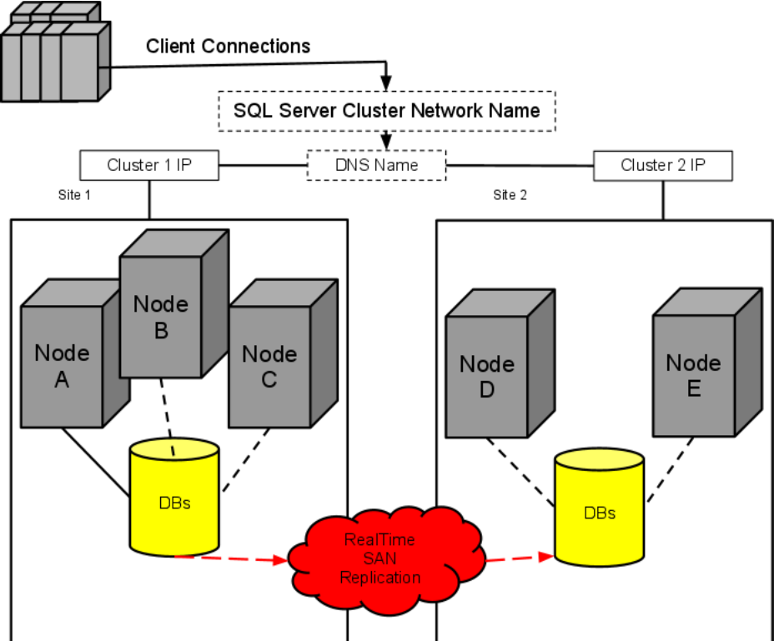

Slide 7
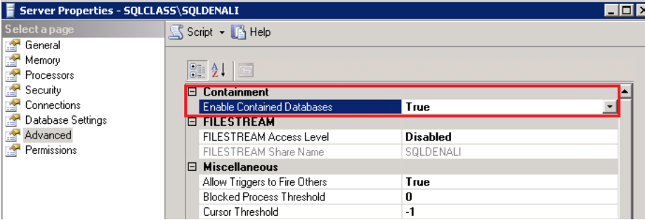
Contained Databases
Enable Contained Databases first!
Cannot use Replication or CDC with Contained Databases
Contained Databases have security and jobs within them
Databases are independent of instance and are portable
No more Orphaned usesrs!!

Slide 8
Contained Databases
Demo Time

Slide 9
Sequence Object
Can view dependencies and current sequence number through GUI
Can reset the sequence using the GUI
Demo Time

Slide 10
Backup/Restore Enhancements
Point-in-Time Restores using GUI
Relocate ALL Option when Restoring
Demo Time

Slide 11
User Defined Server Roles
Allows for separation of duties/roles that are more customized
Database Tuning Advisor
Can run against plan cache

Slide 12
SQL Server 2012 Versions
Datacenter no longer available - most likely SQL Azure will take it's place
New Business Intelligence Edition to be rolled out for 2012
New Licensing structure that uses Cores
Versions rolled over from 2008:
Enterprise
Standard
Express
Web
Compact
Developer
Some Enterprise level features will be available in the Standard Edition

Slide 13
Q&A
Thank you for attending
Special Thanks to Gethyn Ellis & Sharon Dooley for the first ever SQL Denali Course at Learning Tree
http://www.linkedin.com/in/aymansqldba

